Slide 1
Brain Science
History and Overview

Slide 2
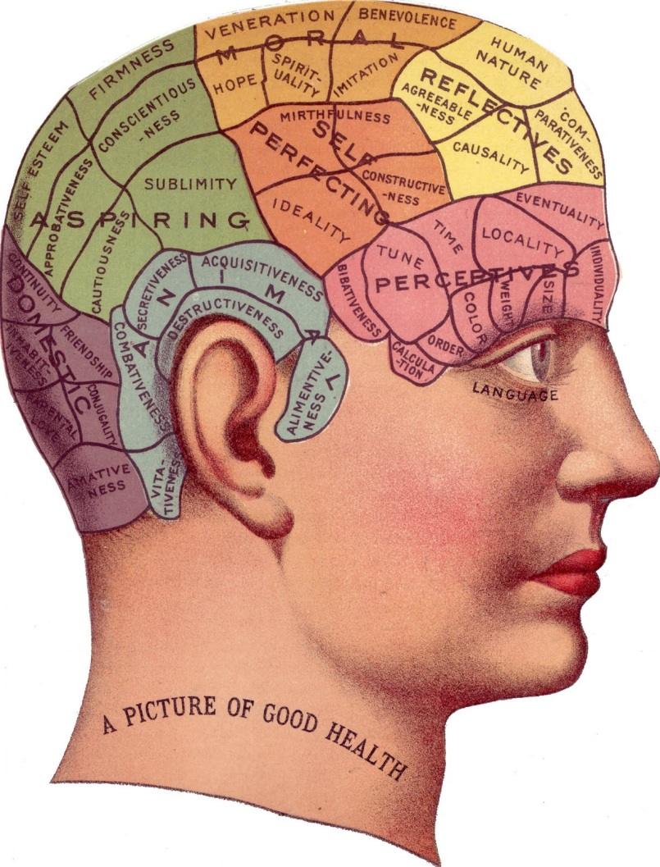
The Early Years: Phrenology

Slide 3
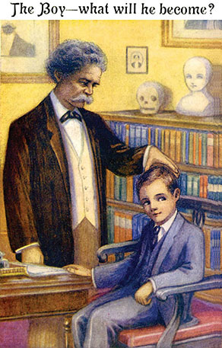
Twain Test

Slide 4
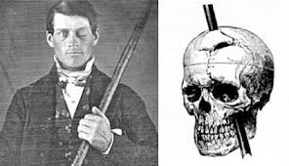
Phineas Gage

Slide 5
Gage “was no longer Gage.”
Resolute
Deferential
“smart, shrewd businessman”
courteous and reverent
Capricious
Chafed at restraint to desires
Lacked money sense
now “fitful [and] irreverent, indulging at times in the grossest profanity.”

Slide 6
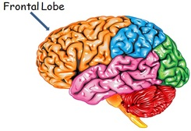
So What?

Slide 7
But Wait
Is this the whole story?
https://www.youtube.com/watch?v=flRamGBSoP4

Slide 8
Big Takeaways
Brain and mind are one
Case studies are tricky to generalize
Brain is amazingly resilient
One of the first case studies to show concrete link (or did it?!?) between behavior and brain.

